Slide 1
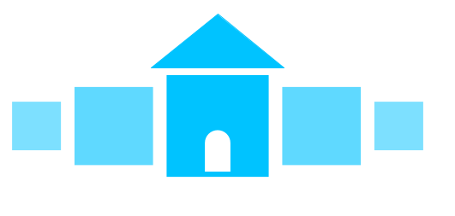
On the Block
Ethereum Smart Contract and Decentralized Application for Rental Contracts
Group 5
Katie Bramlett, Claire Furtick, Genevieve Flynn, & Ada Kilic

Slide 2
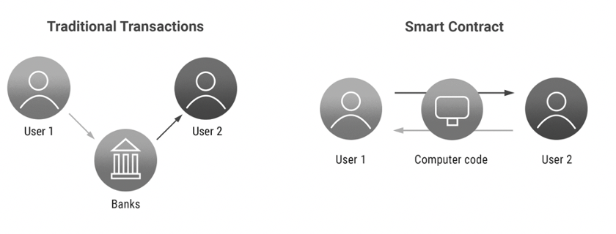
Get SMART with your rental contracts.
Real-world rental contracts often go through a third party intermediary to exchange payment from the tenant to the landlord, which leaves room for error with safety, security, and fairness.
Landlords and tenants should be guaranteed a quick, safe, and fair contract.
Notes:
We want you to get SMART with your rental contracts.
Currently, rental contracts often go through third party intermediaries to exchange payment from the tenant to the landlord, which can often cause problems with security and fairness.
We want our landlords and tenants to have a guaranteed quick, safe, and fair contract.
Using our new technology, we’ll eliminate the need for trusted intermediaries, overall leading to more efficiency and security.

Slide 3
Introducing On the Block
The SMART way to make your rental payments.
On the Block, our Ethereum-based decentralized application, is a streamlined payment portal which can be used to set up timely, recurring rental payments.
Notes:
Introducing On the Block, the smart way to pay your rental payments
On the Block is an Ethereum-based decentralized application, which allows users to easily interact with a smart contract to set up timely, recurring payments
By utilizing an Ethereum-based application, we can streamline the complicated process of paying rent to a landlord

Slide 4





On the Block Features
Set Up Timely Recurring Payments
Terminate Existing Contracts
Start New Rental Contracts
Check Existing Rental Contracts
Get Easy Notifications and Alerts
Notes:
Brief overview of the key features of On the Block

Slide 5
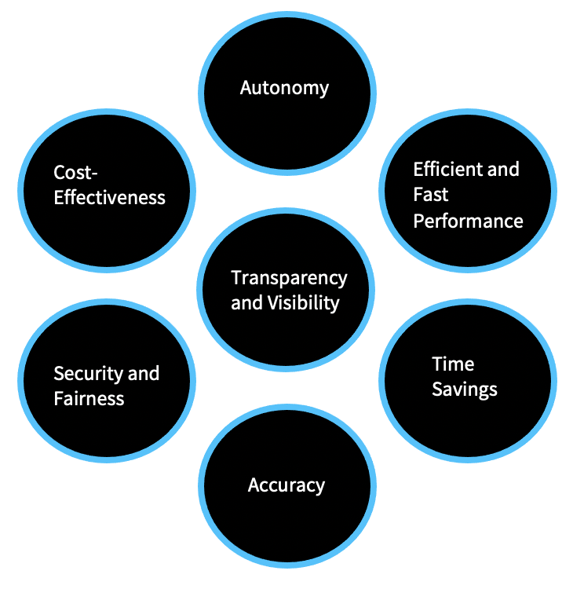
Why is Smart Contract Technology a Better Solution for Rental Contracts?
Notes:
Genny - Smart contract technology offers us numerous benefits for rental contract use cases
Cost-Effectiveness: Smart contracts can replace agents that mediate agreements in cases where agreement terms can be observed publicly and digitally. For example, in legal processes that are dependent upon traditional torts, property, civil procedure, evidence or contract analysis, smart contracts can replace lawyers by automating manual processes.
Time Savings: Due to intermediaries and paperwork of traditional contracts, it takes time to finalize an agreement. Since smart contracts eliminate the need for intermediaries, they can be completed faster.
Security: Blockchain technology makes transactions more secure due to its decentralized structure. For instance, if hackers want to change the dollar amount in a transaction, they would need to control at least more than 50% of all computing power on the blockchain. Though the technology does not make the system unhackable, it certainly makes the process harder.
Accuracy: Since smart contracts are written as computer code, there will be fewer parties to make manual mistakes during the process of contract preparation.

Slide 6
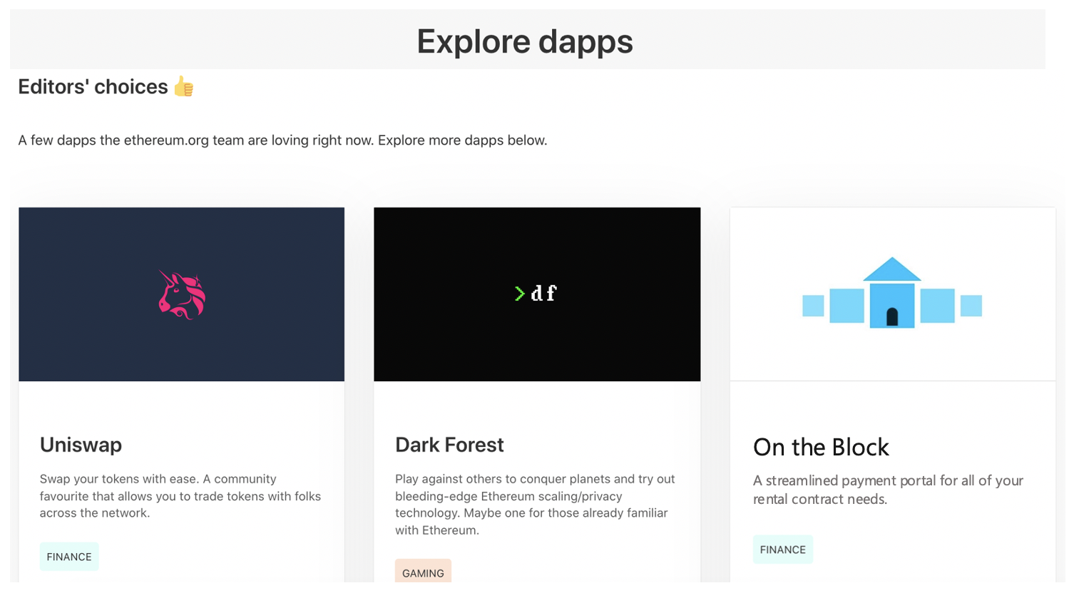
The Growing Demand for Smart Contracts
The global Smart Contracts market size is projected to reach USD 345.4 Million by 2026, from USD 106.7 Million in 2019, at a CAGR¹ of 18.1% during the forecast period 2021-2026.
The rising popularity of Blockchain technology is fueling the demand for the Smart Contracts Market.
(From PRNewsWire)
1: Compound Annual Growth Rate
Notes:
This solution is extremely effective not only in the benefits that it offers, but also that it satisfies the growing demand for smart contracts
Source: https://www.prnewswire.com/in/news-releases/smart-contracts-market-size-to-reach-usd-345-4-million-by-2026-at-cagr-18-1-valuates-reports-832536081.html
CAGR: Compound Annual Growth Rate

Slide 7
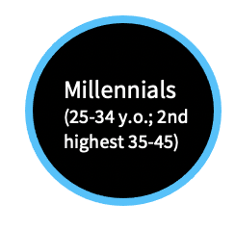
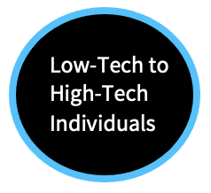
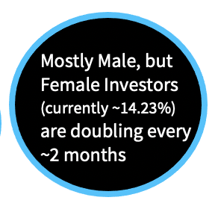

On the Block’s Target Users
Users of, or those interested in setting up, Ethereum and looking to rent
Today’s typical cryptocurrency user
You can be an Ethereum user too.
Quick and Easy Access
Download an Ethereum wallet, get some ETH ($), and try our On the Block dApp today!
Notes:
Our target users are today’s typical cryptocurrency users who are looking to rent
But with the growing demand and push for the smart contracts market -- if you are not yet a crypto or Ethereum user then you can become one in just 3 simple steps: just simply download an ethereum wallet, get some eth, and try out on the block today!
Source:
https://medium.com/@BountyBase/who-are-the-investors-behind-the-300-billion-dollar-crypto-industry-a82a701d1771

Slide 8
Work Cited
https://www.euromoney.com/learning/blockchain-explained/what-is-blockchain
https://www.prnewswire.com/in/news-releases/smart-contracts-market-size-to-reach-usd-345-4-million-by-2026-at-cagr-18-1-valuates-reports-832536081.html
https://cryptocurrencyfacts.com/what-is-ethereum/
https://ethereum.org/en/what-is-ethereum/
https://aws.amazon.com/blockchain/what-is-ethereum/
https://research.aimultiple.com/smart-contracts/
https://medium.com/@BountyBase/who-are-the-investors-behind-the-300-billion-dollar-crypto-industry-a82a701d1771

Slide 9
Backup Slides: “The How”

Slide 10
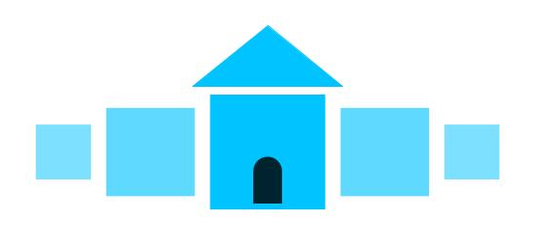
Introducing On the Block
The SMART way to pay your monthly rental payments.
Front End: Decentralized Application (dApp)
Back End: Ethereum Smart Contract
On the Block, our Ethereum decentralized application, allows users to easily interact with a smart contract to set up timely, recurring monthly payments. By utilizing blockchain technology, specifically an Ethereum-based application, we are alleviating the tedious and complicated process of paying rent to a landlord.

Slide 11

An Overview of Smart Contract Technology
Ethereum
Blockchain
Smart
Contracts
Ethereum is an open-source, public, blockchain-based, smart contract-based, decentralized and distributed computing system.
A blockchain is essentially a digital ledger of transactions that is duplicated and distributed across the entire network of computer systems on the blockchain.
A smart contract is simply a program that runs on the Ethereum blockchain.
Notes:
For those who may not know much about this growing technology, blockchains are essentially a digital ledger of transactions
The nature of blockchain technology allows for increased transparency

Slide 13
A Brief Overview of Blockchain Technology
Blockchain is a system of recording information in a way that makes it difficult or impossible to change, hack, or cheat the system.
A blockchain is essentially a digital ledger of transactions that is duplicated and distributed across the entire network of computer systems on the blockchain. Each block in the chain contains a number of transactions, and every time a new transaction occurs on the blockchain, a record of that transaction is added to every participant’s ledger.
This means if one block in one chain was changed, it would be immediately apparent it had been tampered with. If hackers wanted to corrupt a blockchain system, they would have to change every block in the chain, across all of the distributed versions of the chain.

Slide 14
What is Ethereum?
Ethereum is an open-source, public, blockchain-based, smart contract-based, decentralized and distributed computing system that establishes a P2P¹ network that securely executes and verifies application code, called smart contracts. The native cryptocurrency token on the Ethereum network is Ether (ETH).
Smart contracts allow participants to transact with each other without a trusted central authority. Transaction records are immutable, verifiable, and securely distributed across the network, giving participants full ownership and visibility into transaction data.
Blockchains such as Bitcoin and Ethereum are constantly and continually growing as blocks are being added to the chain, which significantly adds to the security of the ledger.
It is the world's programmable blockchain.
1: Peer-to-Peer

Slide 15
Smart Contracts and dApps
A smart contract is simply a program that runs on the Ethereum blockchain. It's a collection of code (its functions) and data (its state) that resides at a specific address on the Ethereum blockchain.
If you consider Smart Contracts as back-end APIs running in the Blockchain, Decentralized Applications (dApps) are the front-end or UX. They represent the visible layer connecting users or other applications with the Smart Contracts running in the Blockchain.
INCLUDE PICTURES OF DAPP HERE !?!?

Slide 16
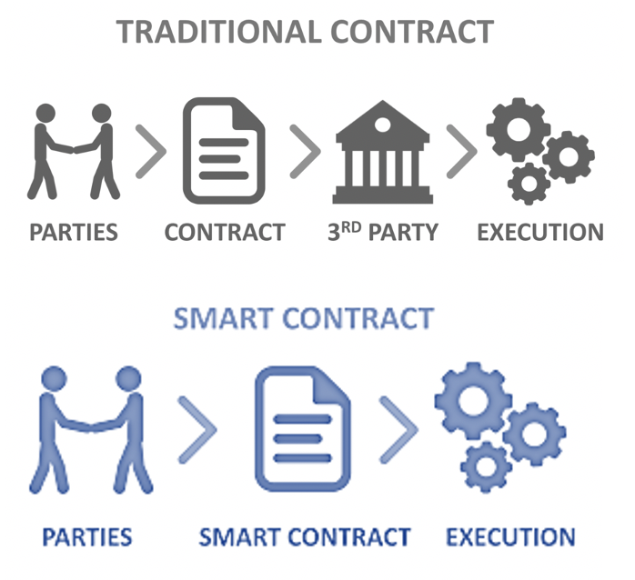
Benefits of Smart Contracts

Slide 17
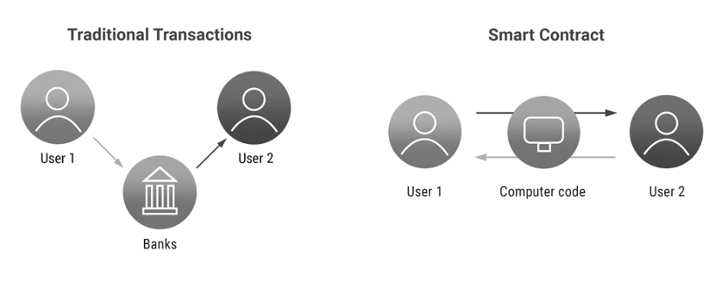
How Do Smart Contracts Work?

Slide 18
The Growing Demand for Smart Contracts
The global Smart Contracts market size is projected to reach USD 345.4 Million by 2026, from USD 106.7 Million in 2019, at a CAGR¹ of 18.1% during the forecast period 2021-2026.
Major factors driving the growth of smart contract market size are increasing adoption of various applications in industries such as supply chain, banking, government, insurance, and real estate.
Furthermore, the rising popularity of Blockchain technology is fueling the demand for the Smart Contracts Market.
(From PRNewsWire)
1: Compound Annual Growth Rate
Notes:
Source: https://www.prnewswire.com/in/news-releases/smart-contracts-market-size-to-reach-usd-345-4-million-by-2026-at-cagr-18-1-valuates-reports-832536081.html
CAGR: Compound Annual Growth Rate

Slide 19
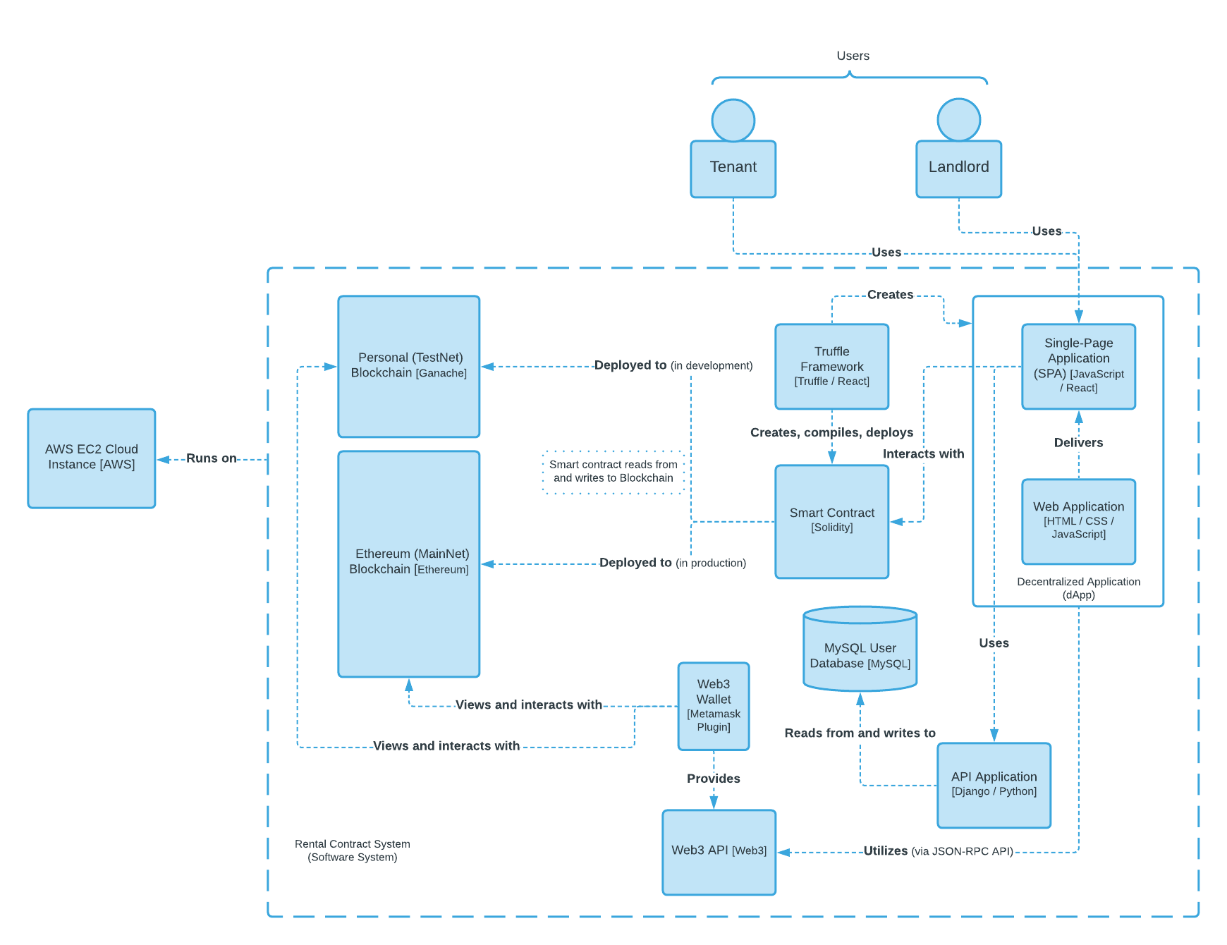
Solution Diagram
From C-4 Software Model, Level 2 Containers

Slide 20
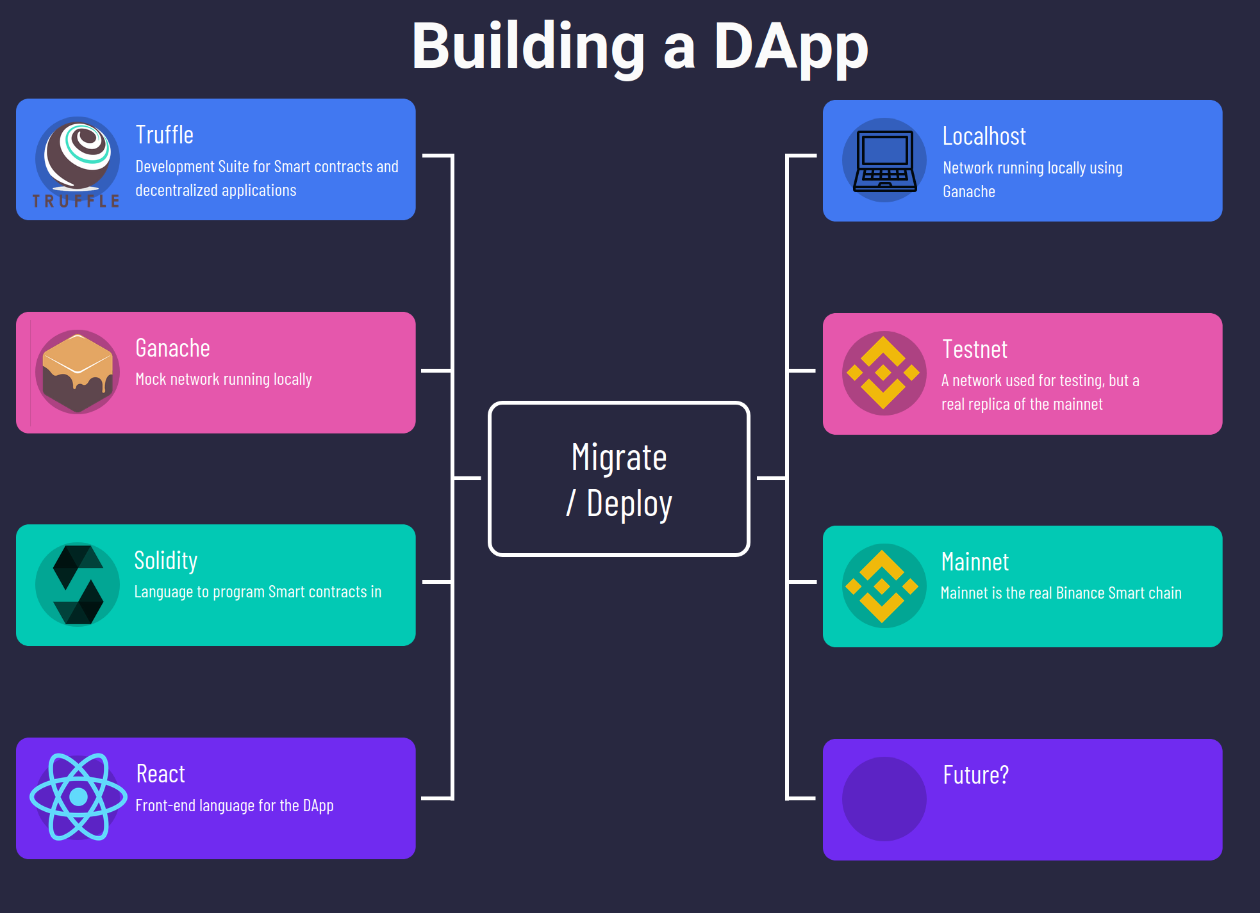
dApp Development

Slide 21
Smart Contract Development

Slide 22
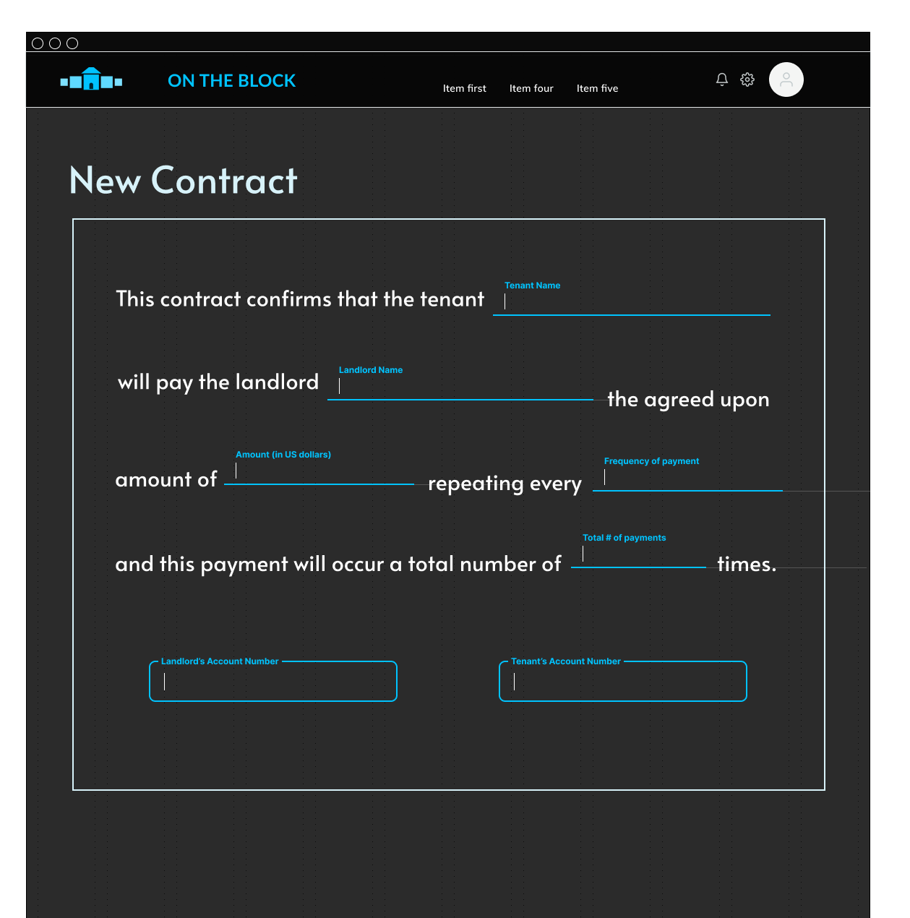
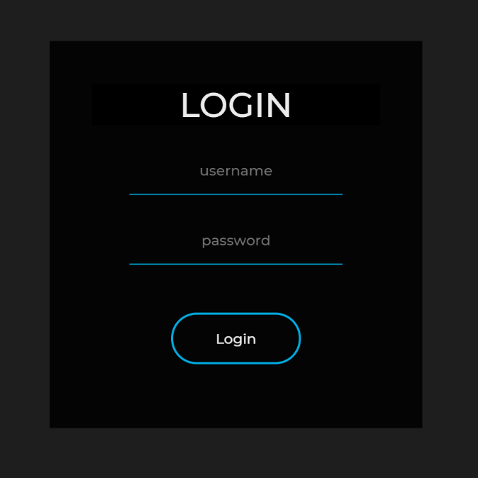
Prototypes

